Slide 1
Ayushman Bharat
Pradhan Mantri Jan Aarogya Yojana
TMS workflow for ICD-11/ICHI for MEDCO/ Hospitals

Slide 2
Updates in TMS workflow with ICD/ICHI
Addition of 4 primary diagnosis fields (one mandatory)
Addition of 8 secondary diagnosis fields (non-mandatory)
ICHI coding mapped with Health Benefit packages
ICD-11 coding is API integrated
Accessible to PPD/CPD to make corrections in codes.

Slide 3
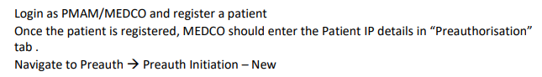
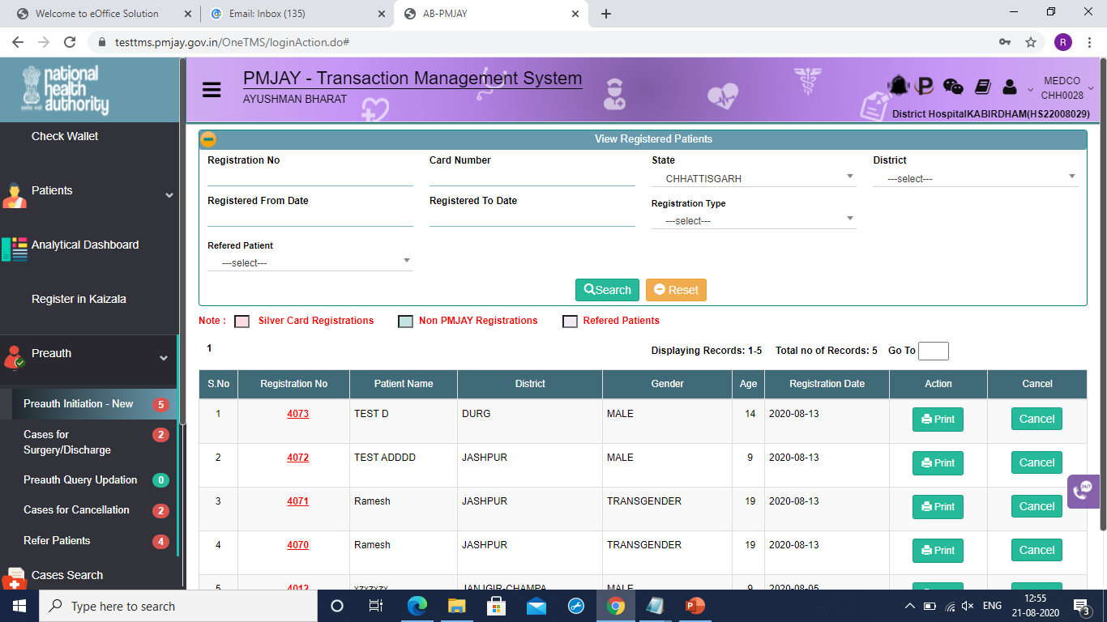
TMS workflow for ICD/ICHI

Slide 4
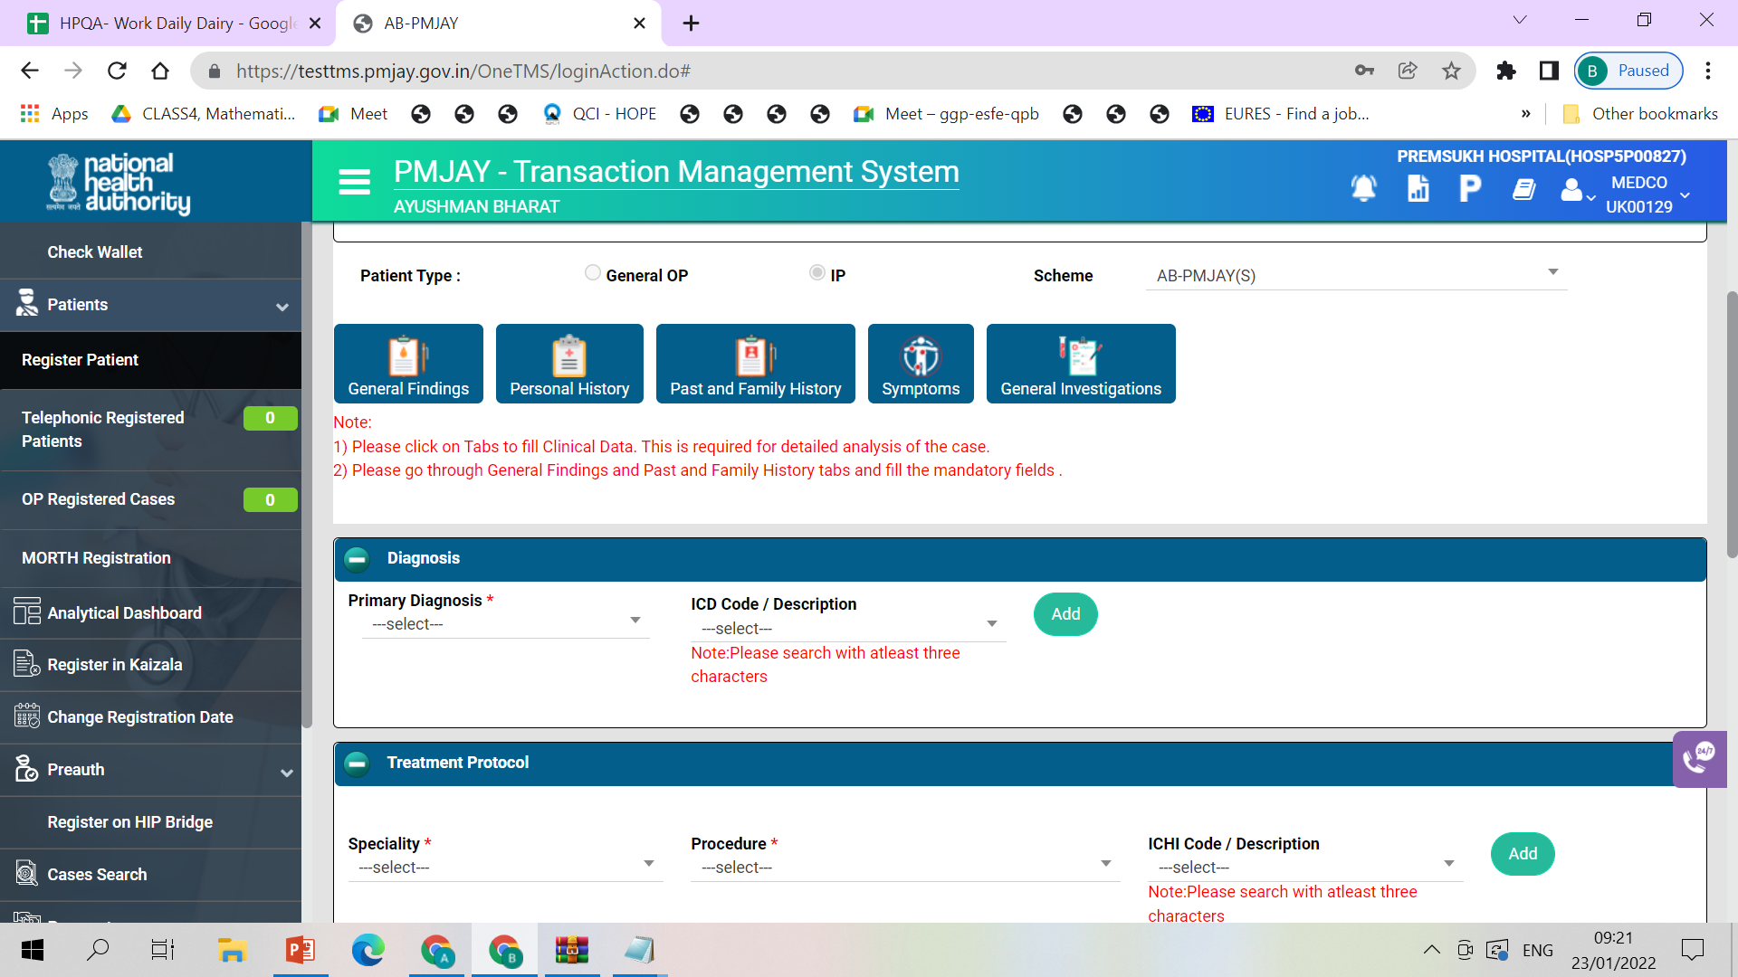
TMS workflow for ICD/ICHI

Slide 5
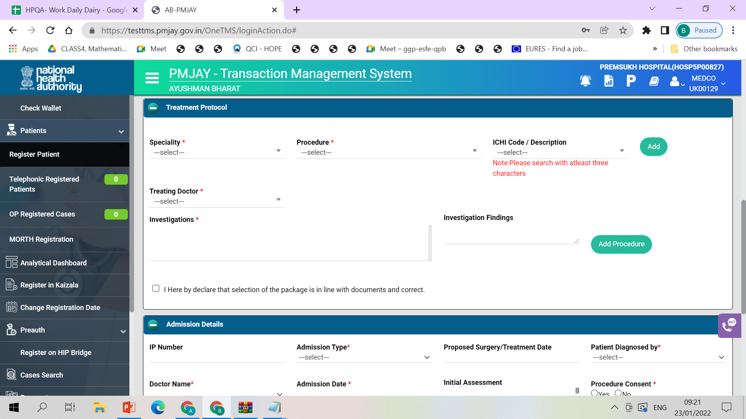
TMS workflow for ICD/ICHI

Slide 6
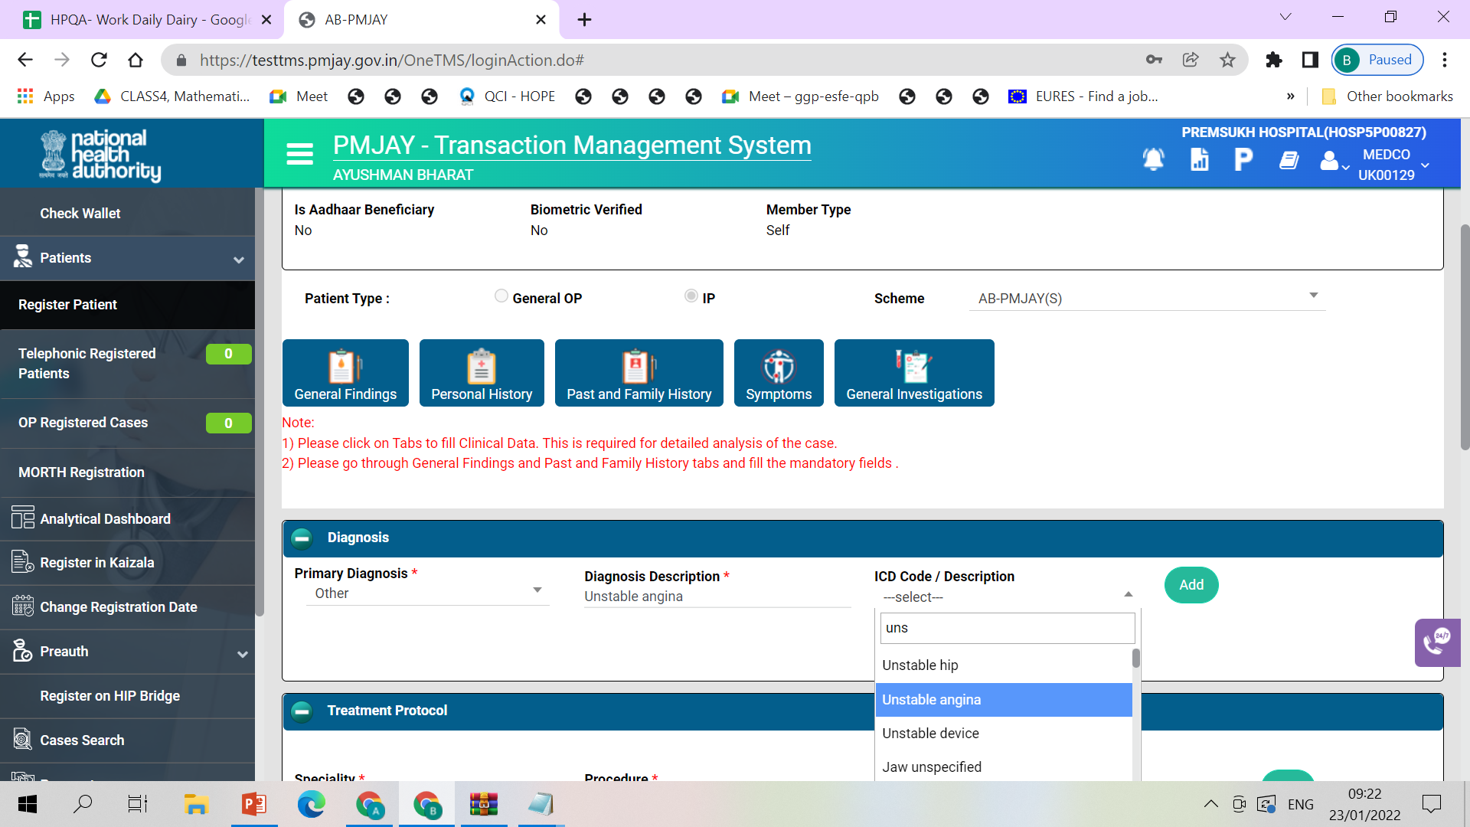
TMS workflow for ICD/ICHI

Slide 7
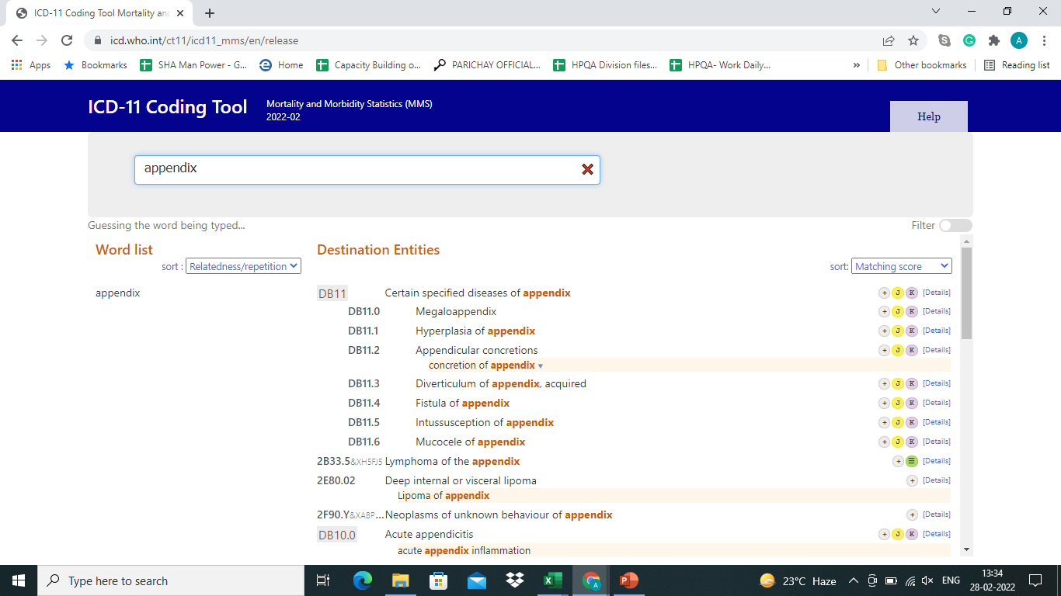
TMS workflow for ICD/ICHI
ICD-11

Slide 8
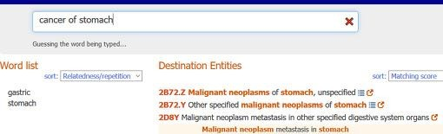
Type a diagnostic statement into the Coding Tool
TMS workflow for ICD/ICHI
e.g. cancer of stomach
The Coding Tool will find the best match

Slide 9
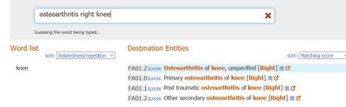
Type a diagnostic statement into the Coding Tool
TMS workflow for ICD/ICHI
e.g. Osteoarthritis of right knee
The Coding Tool will find the best match including the code combination (postcoordination) information for left or right (laterality)

Slide 10
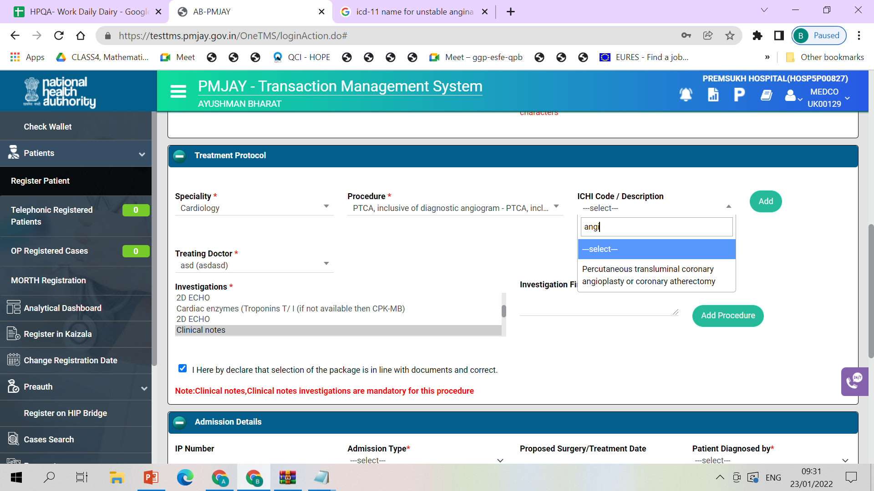
TMS workflow for ICD/ICHI

Slide 11
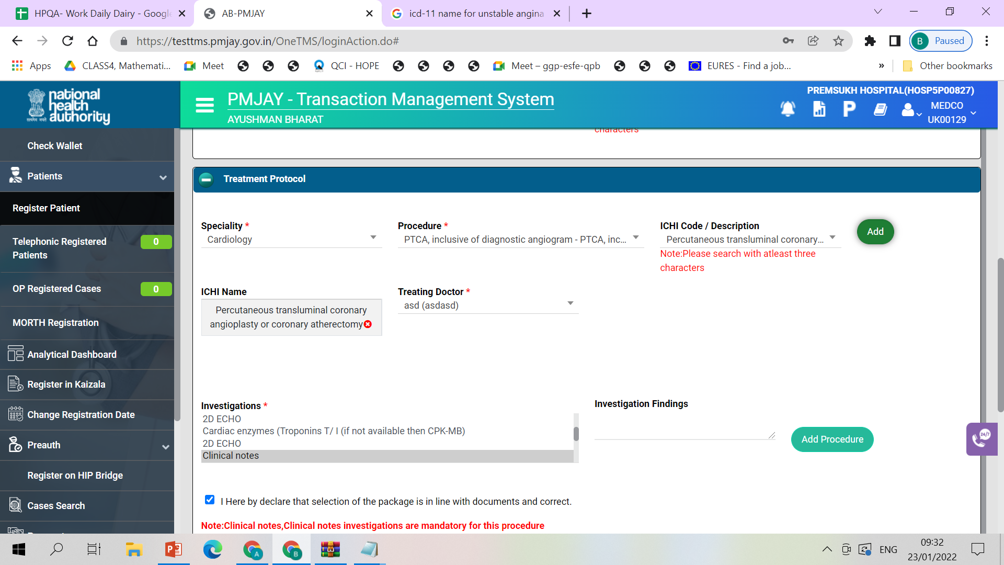
TMS workflow for ICD/ICHI

Slide 12
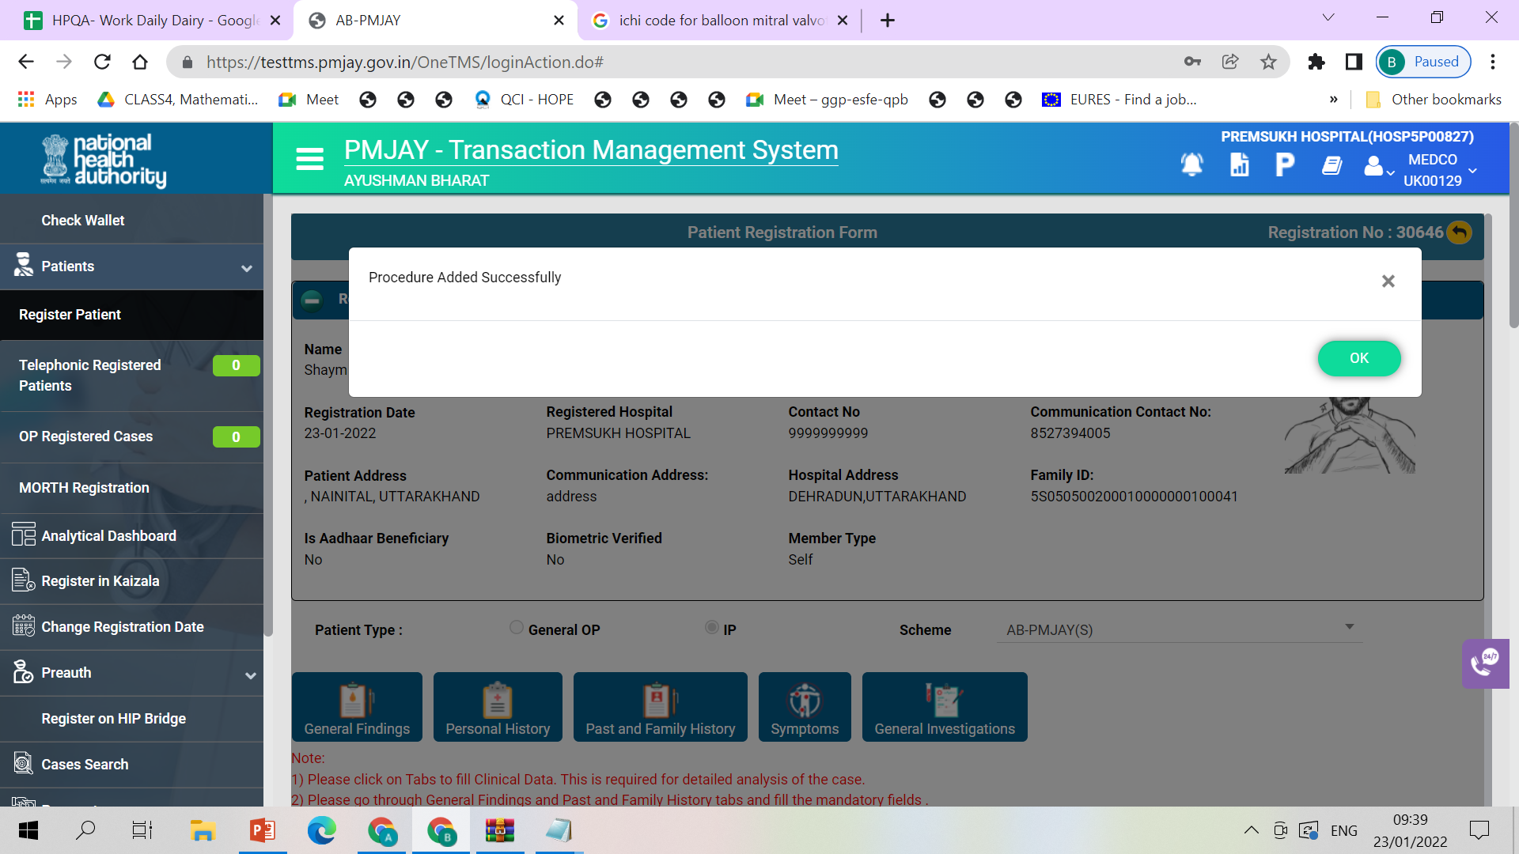
TMS workflow for ICD/ICHI

Slide 13
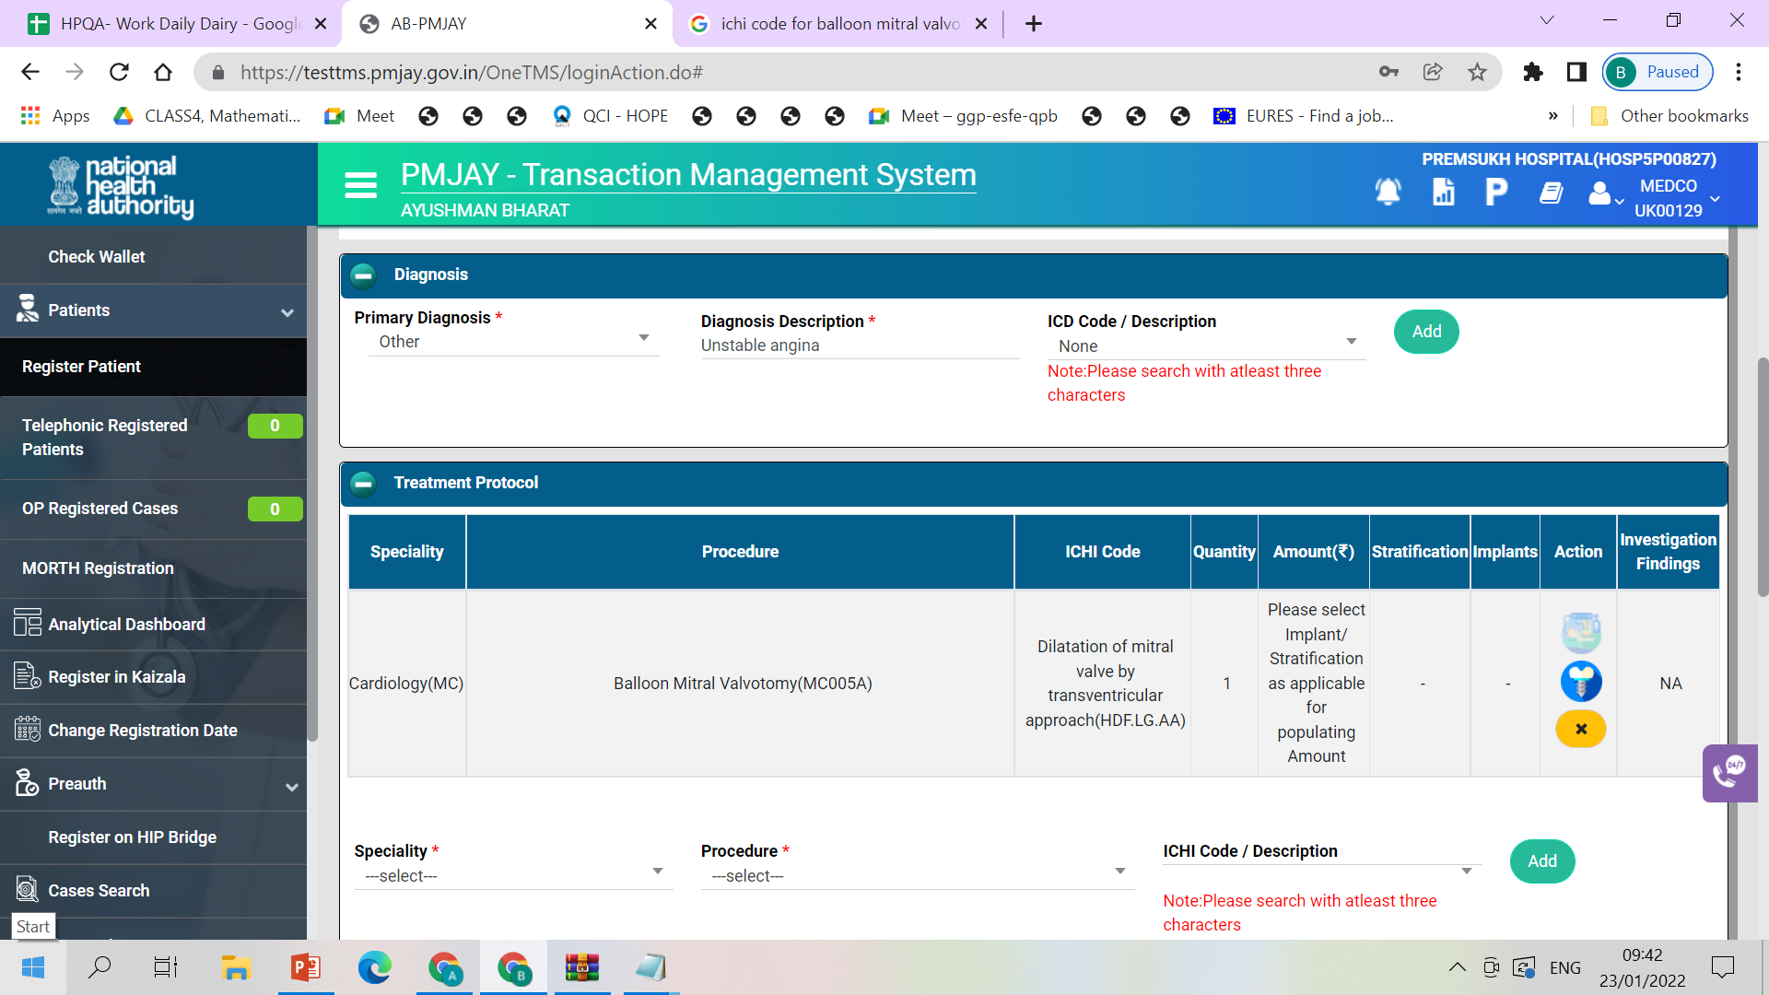
TMS workflow for ICD/ICHI

Slide 14
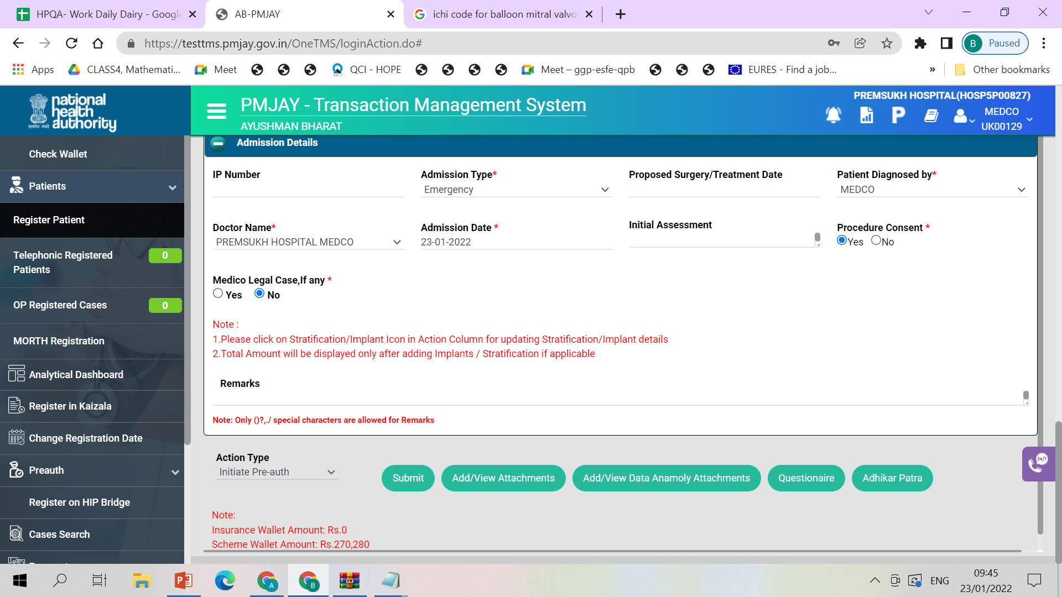
TMS workflow for ICD/ICHI

Slide 15
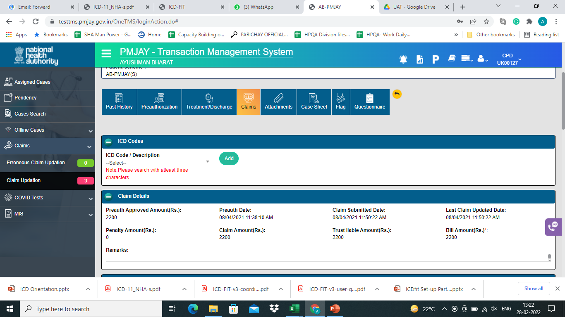
TMS workflow for ICD/ICHI

Slide 16
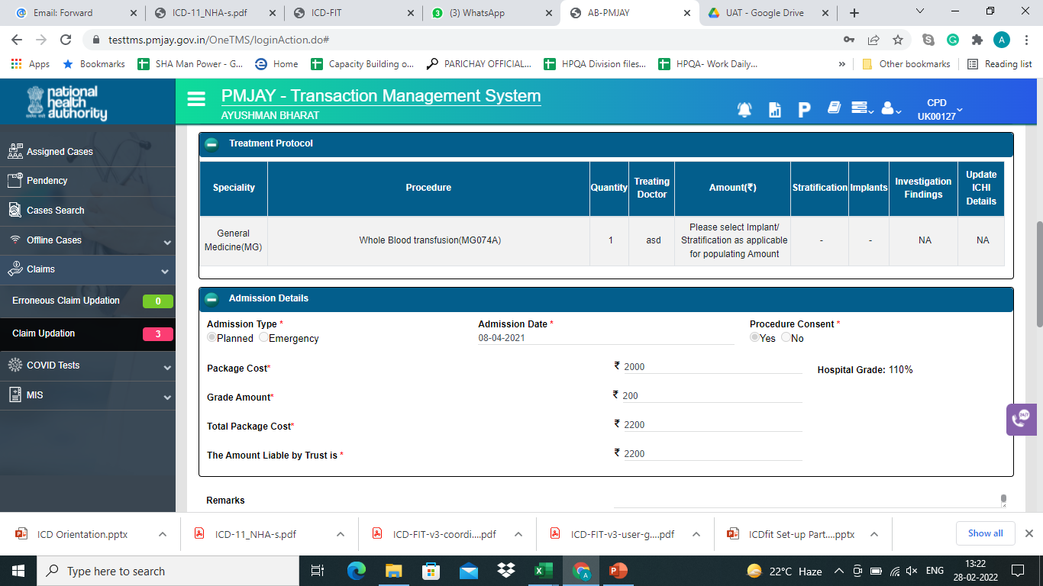
TMS workflow for ICD/ICHI

Slide 17
TMS workflow for ICD/ICHI

Slide 18
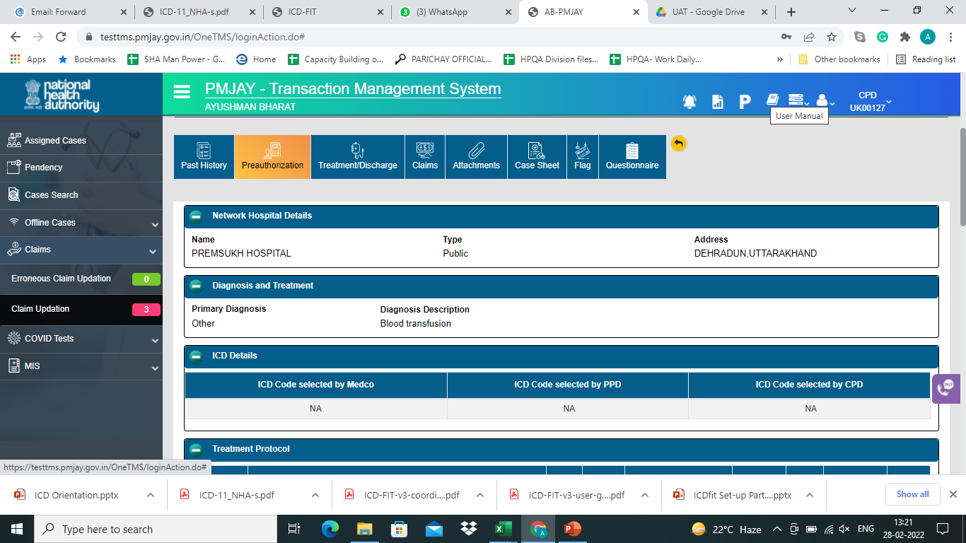
TMS workflow for ICD/ICHI

Slide 19

Looking forward to your support
Thank You

