Slide 1
Orientation of ICD-11/ICHI

Slide 2
Coding
“other specified” & “unspecified” (e.g. residuals)

Slide 3
Classifications
A classification contains groupings of similar entities
  ICD-11 is a classification
Some of these entities will have a specific/individual code
  High frequency disease, statistical relevance, morbidity and mortality needs
  Other entities will NOT have a specific/individual code
    Rare disease, low statistical relevance, poor specificity

Slide 4
Groupings
All groupings have a hierarchy
  For example:
    Anatomy
    Disease type
    Severity
  The hierarchy determines what is an ‘other specified’ or ‘unspecified’ entity for a particular grouping

Slide 5
Other specified & Unspecified
Entities without a specific/individual code are assigned to one of the residual codes of the grouping based on the hierarchy
  Other specified (Y)
  Unspecified (Z)
  If the entity contains hierarchical detail that is not included in the codable entities – assign the ‘Other specified’ residual code
  If the entity does NOT contains hierarchical detail – assign the ‘Unspecified’ residual code

Slide 6
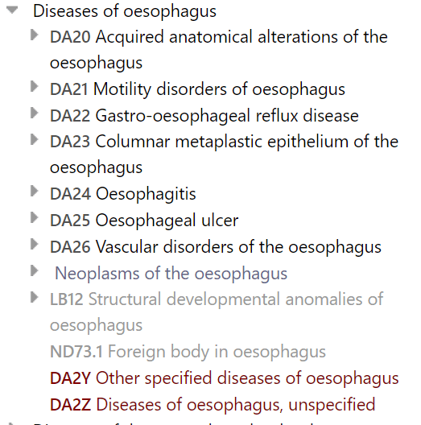
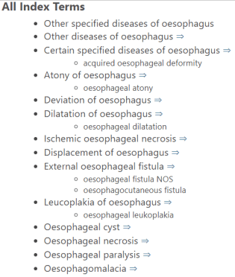
Examples from ICD-11 – ‘Other specified’
DA2Y Other specified diseases of oesophagus

Slide 7
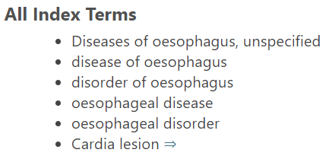
Examples from ICD-11- ‘Unspecified’
DA2Z Diseases of oesophagus, unspecified

Slide 8
Principles of Morbidity coding

Slide 9
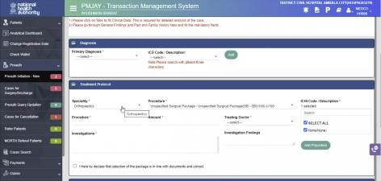
Basics
Good quality diagnoses
  Clearly reported
  Main diagnosis
  Other diagnoses
  Avoid abbreviations
Clearly formulated treatment procedures
  Side treatments – maybe for the other diagnoses (e.g. medication)

Slide 10
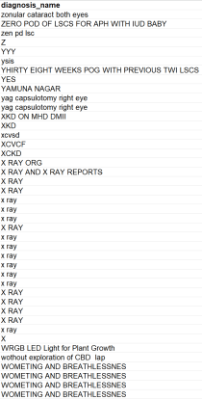
Feedback from the analysis of diagnosis data in TMS
Over 10.000 dx terms refer to “Other”
Diagnosis term is too generic: e.g. ophthalmology, vision problem, Urology, PATIENT ADMITTED UNDER CHRONIC DISEASES etc.
Diagnosis term is confounding multiple diagnosis: e.g. TDM WITH CKD WITH UREMIC ENCEPHALOPATHY WITH SEPSIS
Diagnosis term refers to medical procedures: e.g. plan for lap cholecystectomy, SURGERY, URETEROSCOPY
Diagnosis term use medical jargon: e.g. PHACO PCIOL PLUS SOR; PCI TO LAD AND RCA
Diagnosis term is not referring to diagnosis: e.g. PATIENT ADMISSION, Without Exploration, SAFE CONFINEMENT, PRIVATE WARD, POSITIVE, PATIENT ADDMISION, Sheet Attached
Diagnosis term has spelling mistakes: e.g. unstable ungina, URETRIC CALCULAS, URETRIC CALCULIS

Slide 11
Challenges from a clinical coders perspective
Clinical case description is not diagnosis
If it’s not written well, it can’t be coded well
Clinical statement | Diagnostic statement
Unable to void, for IDC insertion | Urinary retention
Low HB for transfusion | Acute or chronic blood loss anaemia, iron deficiency anaemia
Urine output , will bolus with IV fluids | Dehydration
LUL infiltrate/consolidation, IV antibiotics | LUL pneumonia
Notes:
Here are some examples of the differences in documentation between a clinical statement and what is needed by a clinical coder for code assignment, a ’diagnostic statement’.
If episodes are not coded appropriately (under-coding or incomplete coding due to lack of sufficient clinical documentation), the risk is that the patient episode will not be assigned to the right code/DRG which in turn may impact the accuracy of costing and reimbursement.
Even with an EMR, if clinical documentation is incomplete or conflicting then the coded data will reflect this.
Hospital management, clinicians, clinical coders and IT specialists must work together to ensure the EMR is ‘fit for purpose’ for all!

Slide 12
Main condition and Other conditions
Main condition (principal diagnosis)
  Answers the question: “Why is the patient here today?”
  Is the diagnosis, condition, problem or reason that is responsible for admission, established at the end of the episode of health care.
Other conditions
  All health conditions that co-exist at the time of visit or stay and require or affect patient care, treatment or cost.
  Health conditions that were previously treated or do not longer exist should note be considered as “Other conditions”
The main condition and other condition(s) relevant to an episode of health care should be identified and recorded by the responsible health care practitioner.

Slide 13
General guidance
If diagnosis is an injury or poisoning include the cause of the injury or poising in the diagnosis (e.g. broken leg -> fall from tree).
Include all comorbid condition as “Other condition” that affect treatment or cost (e.g. COVID-19 in asthmatic patient).

Slide 14
Solutions for common mistakes
Multiple diagnoses in Main condition and Other condition field (e.g. Acute appendicitis, T2DM)
  -> write only one diagnosis in each field.
Procedure written in diagnosis field
  -> write the diagnosis for which procedure was done
Do not use terms or symbols that indicate uncertainty regarding the diagnosis (e.g. “Breast cancer??” vs Breast lump)
  -> indicate suspicions or thoughts on the case separately in the notes section.
Main condition field retains symptom although confirmed diagnosis is available
  -> write confirmed diagnosis in Main condition field if available before the end of stay or visit (Breast lump vs. breast cancer)
Only some chronic condition is mentioned without indicating the reason for the particular visit or stay (e.g. “Diabetes” but patient comes for treatment of acute condition)
  -> record the reason for the particular episode of care
Main condition field is empty because the patient has no complaint
  -> record instead of the diagnosis the reason for encounter (i.e. ICD-11 Chapter 24)

Slide 15
THANK YOU

