Slide 1
Orientation of ICD-11/ICHI

Slide 2
ICD-11 Basic coding
Basic scenarios for finding an ICD-11 code using the coding tool

Slide 3
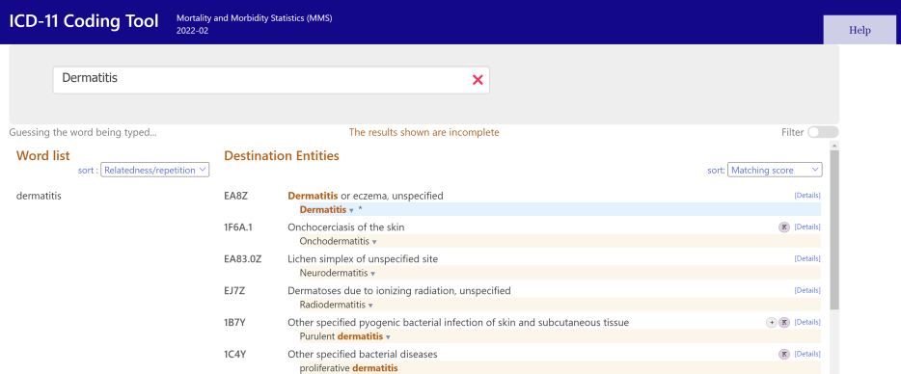
Search term renders blue highlighted stem code
Example: Dermatitis

Slide 4
ICD-11 has two types of codes
Stem codes
Start with number 1-9 or letter A-S
Can be used alone
Extension codes
Start with letter: X
Cannot be used alone

Slide 5
ICD-11 codes can be combined:
two or more stem codes
adding extension code to a stem code.
This is called post-coordination (postC)

Slide 6
Symbols when combining codes
Stem code 1 / Stem code 2
Stems code 1 & Extension code 1

Slide 7
ICD-11 Smart search with automated indexing of mandatory post Example: Diabetic cataract with 2TDM

Slide 8
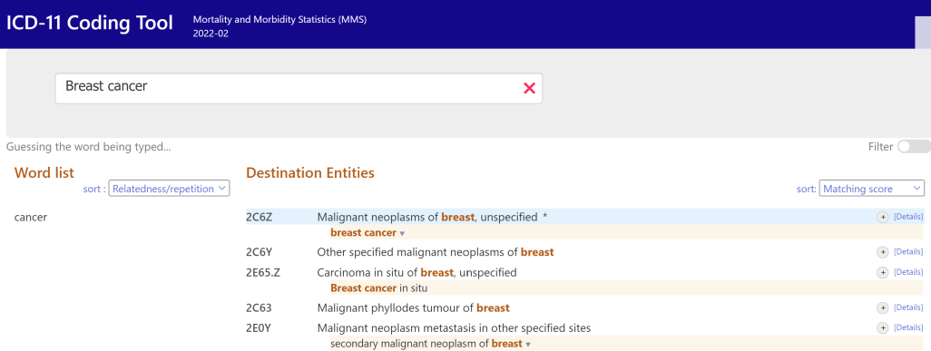
Search term renders stem code with optional postC (grey icon)
Example: breast cancer

Slide 9
Search term renders blue highlighted stem code
Example: Dermatitis

Slide 10
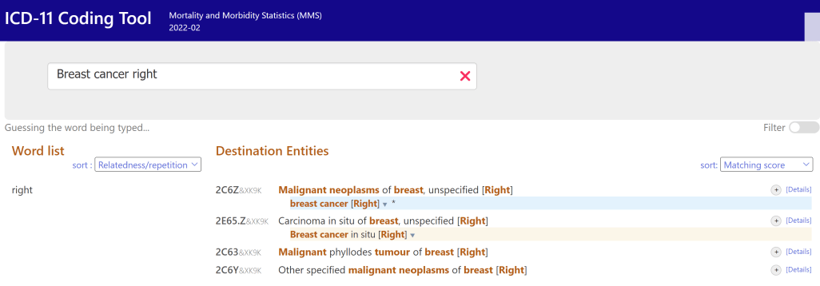
ICD-11 Smart search with automated indexing of
optional postC
Example: Breast cancer, right

Slide 11
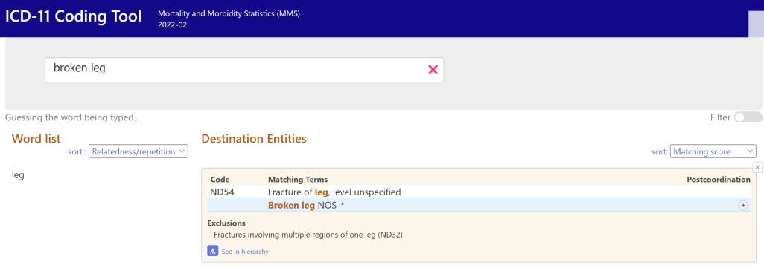
What to do if you don’t get a search result?
Break down your search term. For example: Broken leg after fall from tree.
Search for injury: “broken leg”, subsequently search for External cause: “fall from tree”

Slide 12
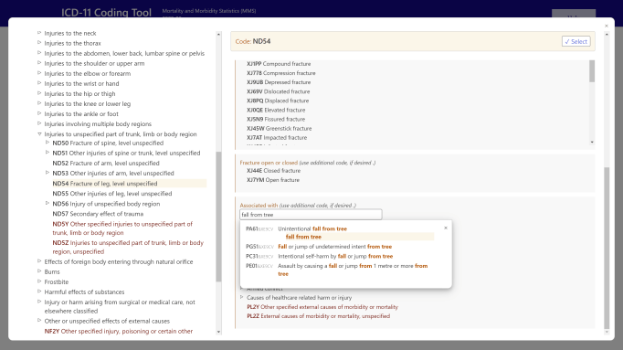
What to do if you don’t get a search result? (cont.)
Break down your search term. For example: “Broken leg after fall from tree”.
Search for injury: “broken leg”, subsequently search for External cause: “fall from tree” in the search field “associated with”

Slide 13
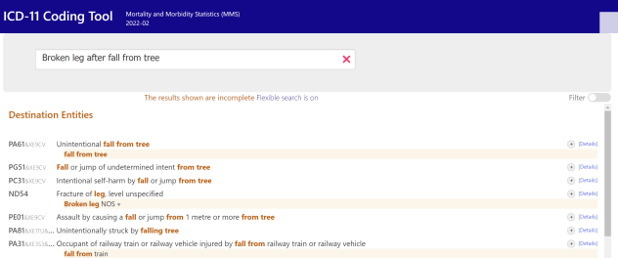
What to do if you don’t get a search result? (cont.)
Use “flexi search”

Slide 14
Additional coding tool guidance: maternal & perinatal conditions

Slide 15
ICD-11 Tooling

Slide 16
Capturing clinical terms with the ICD-11 coding tool

Slide 17
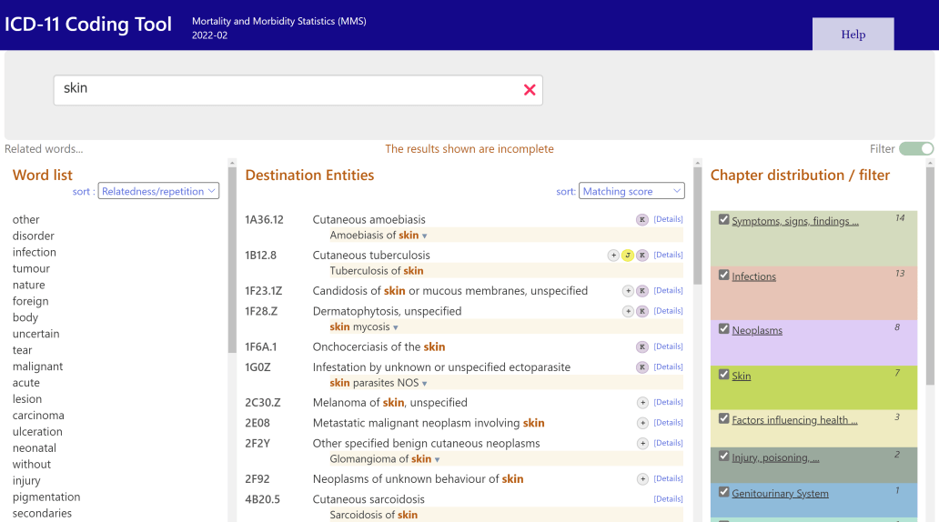

Slide 18
Smart search features in ICD-11
Similar words (tuberculosis – tuberculous)
Aware of Spelling variants (edema, oedema)
Understand synonyms (renal - kidney) (cancer – malignant neoplasm)
Diacritic normalization (behcet, behçet)
Handling compound words (Searching myelitis will get you “Neuromyelitis” “polymyelitis” as well).

Slide 19
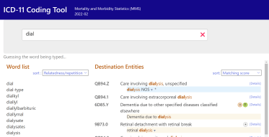
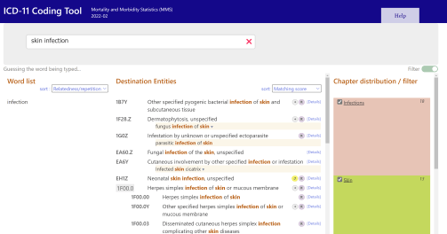
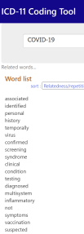
Smart search features in ICD-11 (cont.)
Supports word completion during search
Search results dynamically available as user types
Organized by matching score and classification hierarchy
Relevance based word suggestion
You may click instead of typing the next word
Sorting by alphabetical order is also provided

Slide 20
ICD-11 Index terms includes local term variations
Synonyms in the English version
e.g. end-stage renal failure underGB61.5 Chronic kidney disease, Stage 5

Slide 21
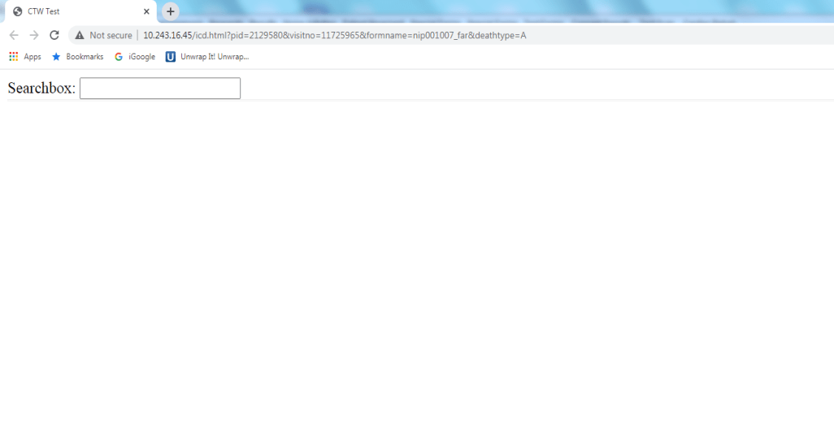
STEMI
Source: Dr. Islam Ibrahim, WHO FIC CC Kuwait

Slide 22
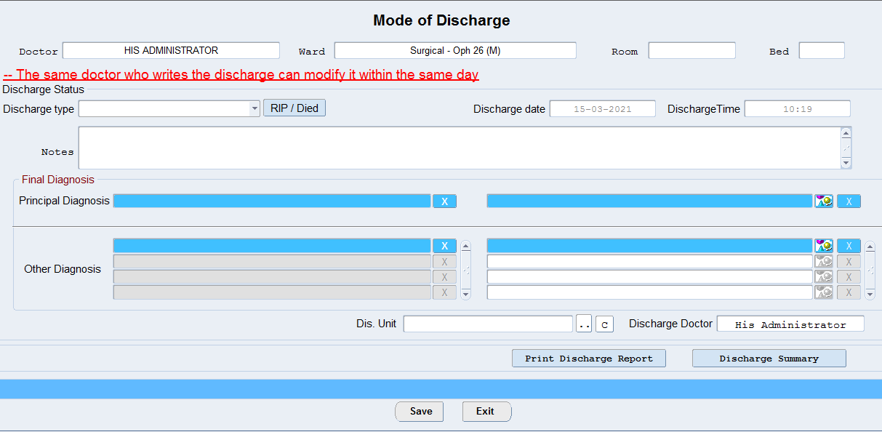
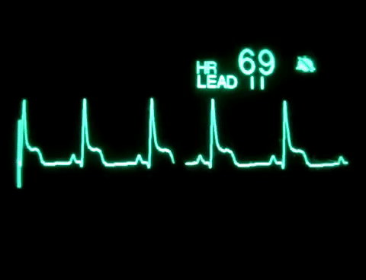
Acute ST elevation myocardial infarction
STEMI
STEMI

Slide 23
THANK YOU

