Slide 1
Orientation of ICD-11/ICHI

Slide 2
Overview of
ICD-11/ICHI

Slide 3
Terminology
ICD
International Classification of Diseases
International Statistical Classification of Diseases and related health problems
ICHI
International Classification of Health Interventions
Interventions for treatment, prevention and diagnostics: medical, nursing, rehabilitation, laboratory, imaging, ultrasound, public health.

Slide 4


Common Foundation
Extension Codes WHO Terminologies
ICD
WHO INN (non proprietary names - medicaments)
WHO Devices
ICD-O - Histopathology (tumours)
Anatomy
Details of external causes
Severity
Infectious agents
WHO core classifications
ICHI
Related Classifications, Terminologies, Standards
ICF
ICNP Nursing
ICPC Family med. Aspects
ATC Medicament dosage use
Orphanet Rare diseases
LOINC/NPU Laboratory
Other systems (OBO, HPO, SNOMED,
MedDRA)
WHO - FIC

Slide 5
ICD-11
Legally mandated health data standard (WHO Constitution and Nomenclature Regulations)
In effect from January 2022
Conceptual framework independent of language and culture
Integration of terminology and classification
End-to-end digital solution (API, tools, online and offline)
Up-to-date scientific knowledge
Comparable statistics and semantic interoperability - for 150 years
Distributed under Creative Commons Attribution-NoDerivs 3.0 IGO license

Slide 6
ICD Purpose and Uses
As a classification and terminology ICD-11:
Allows the systematic recording, analysis, interpretation and comparison of mortality and morbidity data collected in different countries or regions and at different times;
Ensures semantic interoperability and reusability of recorded data for the different use cases beyond mere health statistics, including decision support, resource allocation, reimbursement, guidelines and more.

Slide 7
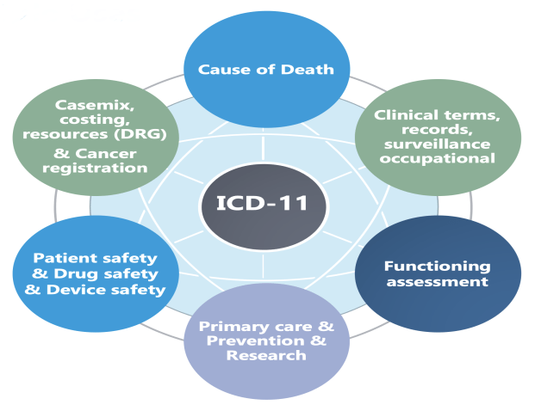
Designed for Multiple Uses

Slide 8



ICD-10
Codes and URI Combinations:
14 000
stat. categories (codes)
Statistical system imposed for clinical use
Separate text index
Primitive structure with focus on statistics.
Missing a lot of clinical detail
Print product
Separate rule base
Need terminology link
30 years outdated content
WO - FIC

Slide 9





ICD-11
Codes and URI Combinations:
17 000
stat. categories (codes)
Clinical systems for statistical use
Ontology with multiple parenting from which statistical information is derived.
All desired clinical detail
codable, eventually with code combinations
More detail beyond statistical categories (foundation in yellow)
Input from clinical modifications of ICD-10
80 000
entities
120 000
terms
>1600 000
terms with formalized post-
coordination
Searchable in “Google style” without training

Slide 10
Updation in Version-11
New chapters and sections
Diseases of the immune system
Sleep wake disorders
Conditions related to sexual health
Optional section Traditional Medicine Conditions
Disability assessment Scheme (WHO-DAS)
Redesigned Diseases of Skin
Improved functioning of External causes
In line with major international initiatives, as
Patient safety reporting
Antimicrobial resistance documentation
Detail for DRG (integration of clinical modifications of ICD)
Detail for primary care

Slide 11
Updation in Version-11
Codes for COVID-19
Neoplasms
New hierarchy
Inclusion of histopathology, basalioma, melanoma types Coding for Grade and Stage
Nervous system
More clinical detail
Moved cerebrovascular diseases here
Cardiovascular system
Myocardial infarction STEMI- non-STEMI
updated arrhythmias and pulmonary hypertension

Slide 12
ICD-11 - statistical core (26 chapters)
Traditional medicine conditions
(optional dual coding)
Need for
Need for treatment of illnesses
Ancient
Health
Conditions need specific treatment
Ancient
External
services
Chinese roots
India roots
cause
Conditions
Factors
Maternal
Neonate
General population
influencing
Trauma
Infection
Congenital
Tumour
Other
Functioning
assessment (WHO DAS2)
Immune
Blood
Psychiatry
Eye
Respiratory
Skin
Urogenital
Sexual
system
Ear
Health
Endocrine
Neuro
Cardiovascular
Digestive
Musculoskeletal
Signs
Symptoms
Sleep-
Wake

Slide 13






Extension codes - Terminology
Coding Pattern
Conditions - Classification
Diagnoses Injuries Signs Symptoms Findings
Severity Temporality Anatomy Laterality Consciousness
Infectious agents and AMR Histopathology (ICD-O)
Chemicals and Medicaments (INN) Devices
Mechanisms of harm (Safety) Activities
Places Objects
Reasons for encounter or health status
External causes of illness & death
Traditional medicine conditions
Functioning assessment – WHO-DAS2

Slide 14
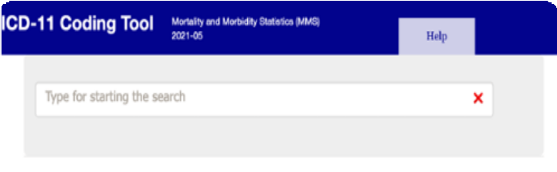

Easy to use multiple tools
Guide for implementation of ICD-11* timelines – steps – questions
Mappings
ICD-11 self learning training online
Field implementation and testing platform
Webinars and online class for coding
DRG system (under development)
API and coding tool that can be embedded LOCALLY or ONLINE

Slide 15
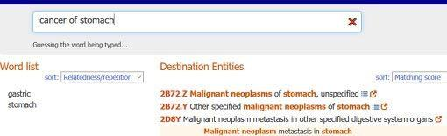
Type a diagnostic statement into the Coding Tool
Easy to use
e.g. cancer of stomach
The Coding Tool will find the best match

Slide 16
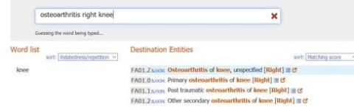
Type a diagnostic statement into the Coding Tool
Easy to use
e.g. Osteoarthritis of right knee
The Coding Tool will find the best match including the code combination (postcoordination) information for left or right (laterality)

Slide 17
ICD-11 Benefits
Improved usability
Less training
Easily add all clinical detail Add terms
Improved usability
Less training
Easily add all clinical detail Add terms
Up-to-date scientific knowledge
Better use of health resources
DRG
Patient Safety
Improved incorporation in electronic environments
Clinical terms
Linkage to relevant other classifications and terminologies Online and offline –digital – paper
Creative commons license = free for commercial and non- commercial use

Slide 18
ICHI multiple uses
The International Classification of Health Interventions (ICHI) is a common tool for reporting and analysing health interventions for clinical and statistical purposes.
ICHI covers interventions carried out by a broad range of providers across the full scope of health systems and includes interventions on: diagnostic, medical, surgical, mental health, primary care, allied health, functioning support, rehabilitation, traditional medicine and public health.
The classification is built around three axes: Target (the entity on which the Action is carried out), Action (a deed done by an actor to a target) and Means (the processes and methods by which the Action is carried out).
ICHI

Slide 19
ICHI multiple uses
Extension codes are shared with ICD and ICF in the common foundation and allow users to describe additional detail about the intervention in addition to the relevant ICHI code. A simple, logical syntax links ICHI stem codes and extension codes, interventions performed together, and packages of interventions.
The number of categories in ICHI, is determined with regard to the use cases for ICHI and the need for stability of the classification over time. The terminological core allows for a high level of detail (granularity) for all kinds of clinical documentation and data usage.
The Beta-3 version of ICHI was released in October 2020. The component relating to clinical interventions has been finalized. The components on functioning interventions and public health interventions are under final review and are finalized 2021

Slide 20
ICHI multiple uses
National use of ICHI
Patient safety and quality
Health System Performance
Framework for WHO interventions
International comparison Sustainable Development indicators
Universal Health indicators – essential interventions

Slide 21
THANK YOU

